Slide 1
4A
IS SHE HIS WIFE OR HIS SISTER?

Slide 2
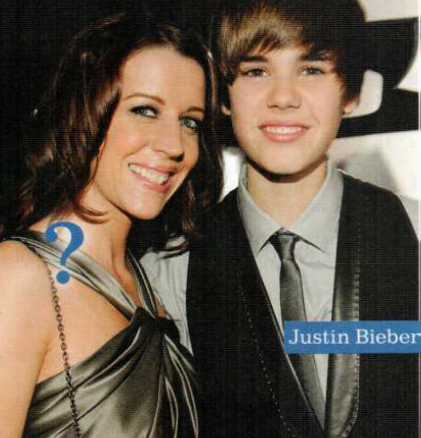

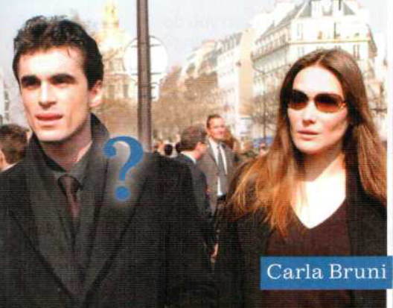
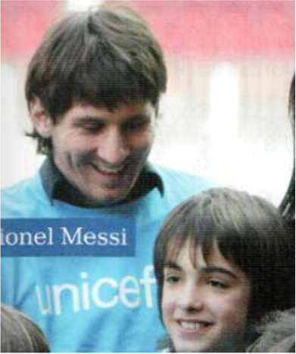
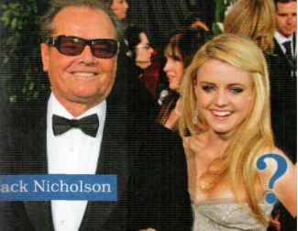
WHO ARE THESE PEOPLE?
Page 28

Slide 3
Who is he with? / Who is she with?
He is with his mother.
She is Justin Bieber’s mother.
She is with her ex-boyfriend.
He is Carla Bruni’s ex-boyfriend
She is Jack Nicholson’s daughter

Slide 4
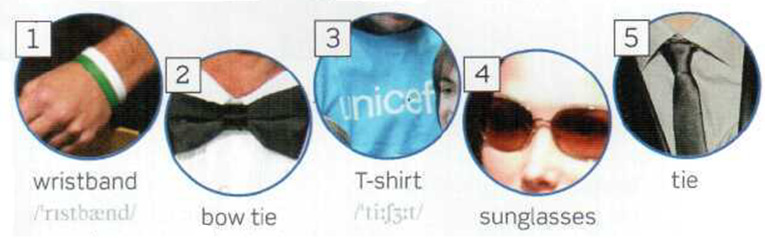
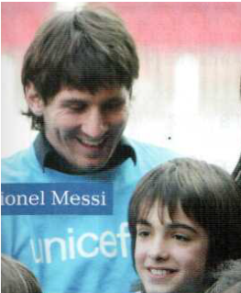
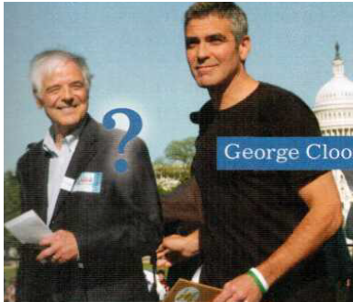
WHOSE ARE THESE THINGS?

Slide 5
Whose is the wristband? Whose are the glasses?
It’s George Clooney’s wristband.
They are Carla Bruni’s sunglasses.
Whose is the t-shirt?
It is Messi’s t-shirt

Slide 6
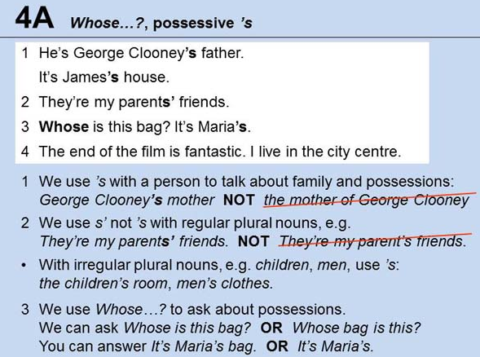

Slide 7
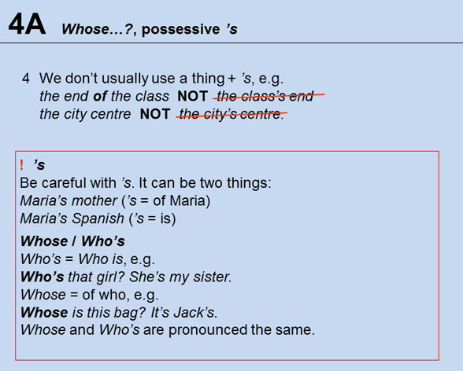

Slide 8
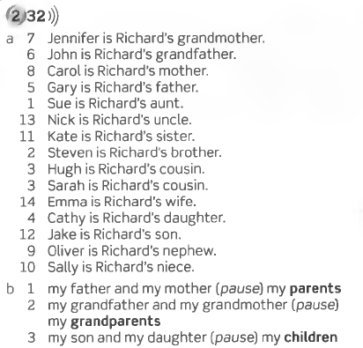
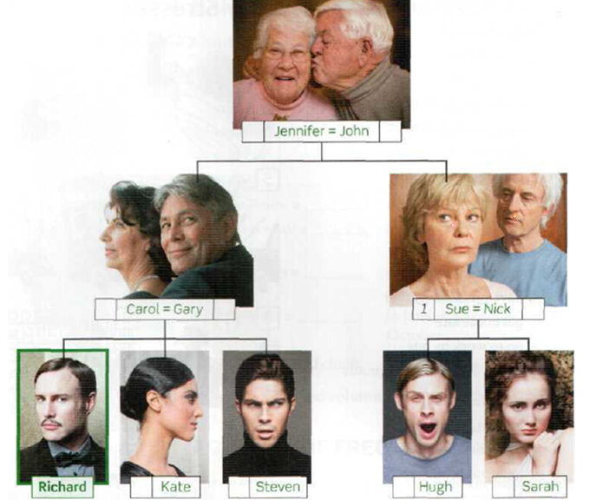
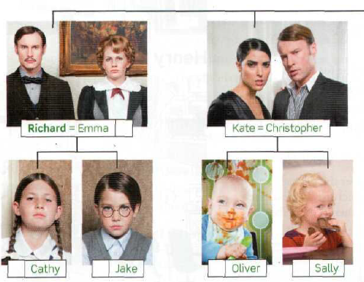
From Richard’s point of view)

Slide 9

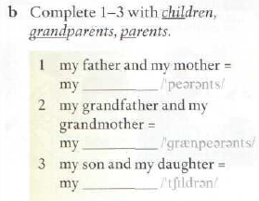
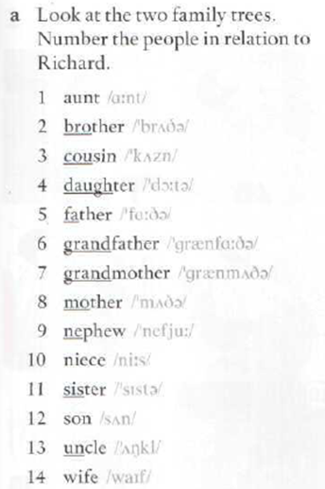

Slide 10
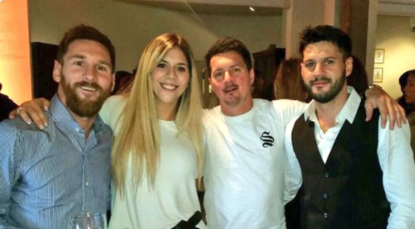
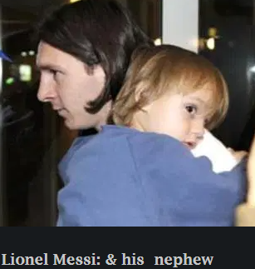
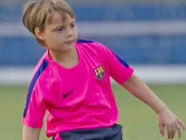
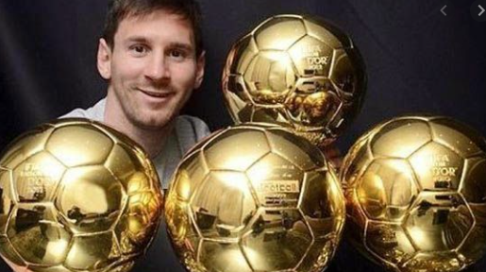
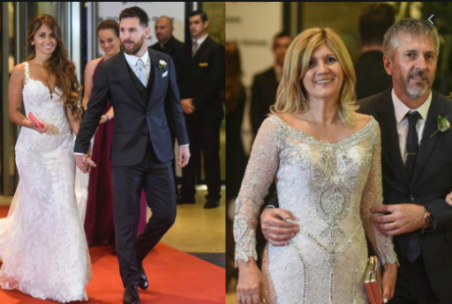
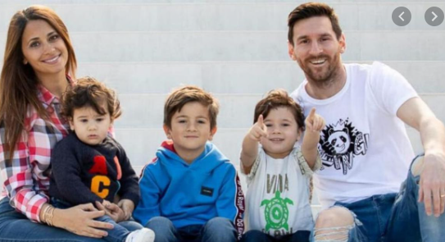
LIONEL MESSI’S …

Slide 11
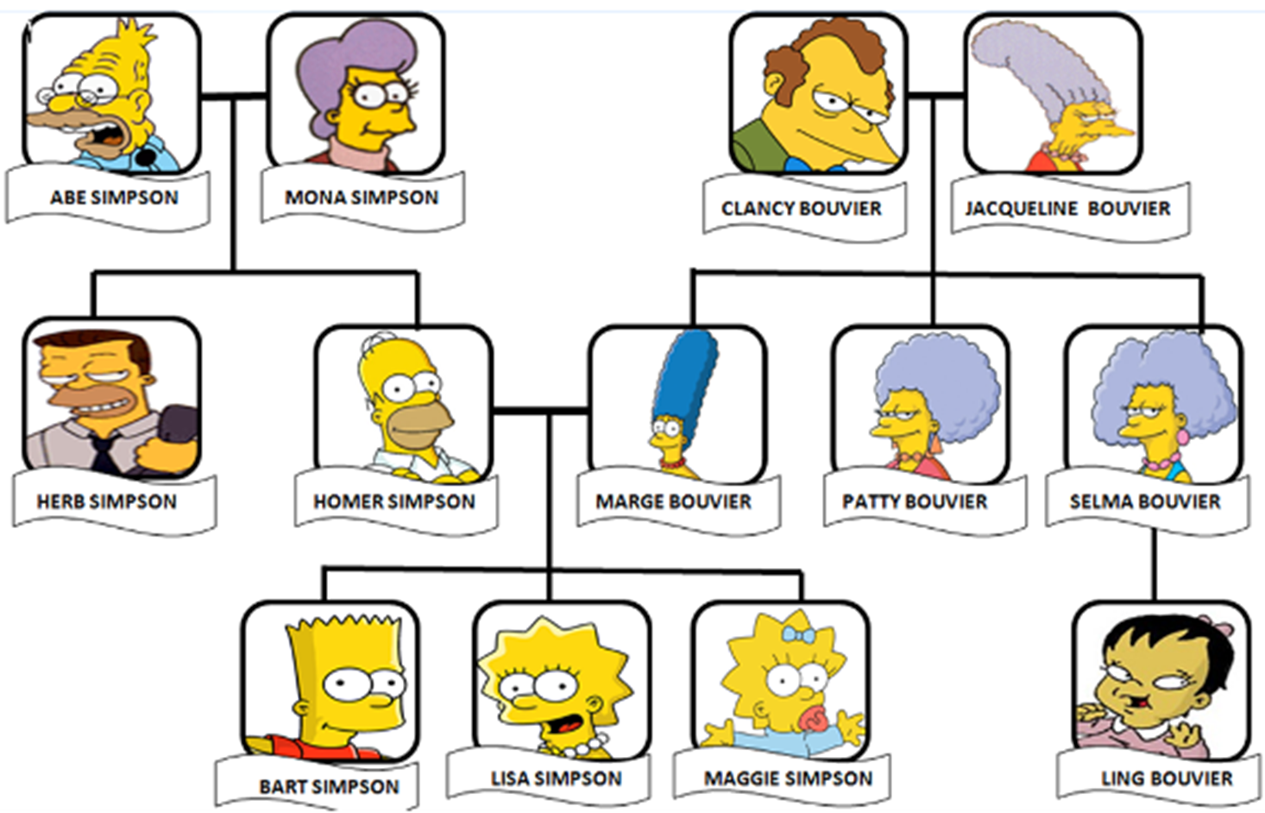

Slide 12

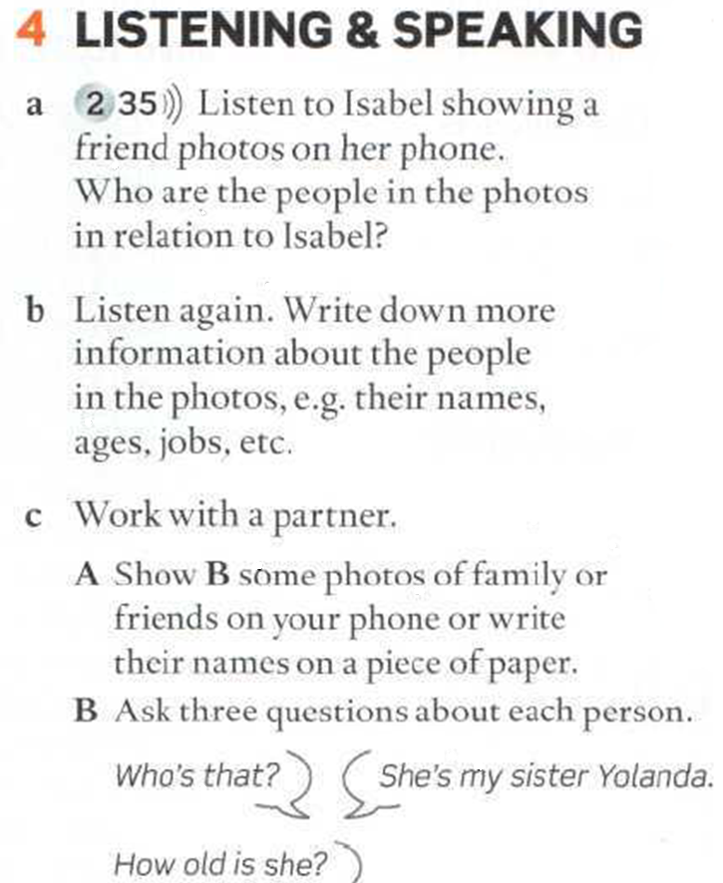

Slide 13
A = Anna, I = Isabel
A Who’s that? I That’s my boyfriend, Alex.
A He’s good-looking. How old is he? I 26.
A What does he do? I He’s a policeman.
A Really! Does he like it? I Yes, he loves it. And this is my dad.
A He looks very young. I Well, he’s fifty-five this year.
A He doesn’t look fifty-five! Is that your mother? I No, that’s Gloria, my stepmother.
A Is she nice? I Yes, she’s great. She’s a hairdresser – she
does my hair for free!
A That’s good. Who’s that? I That’s Natalie.
A Who’s she? I My brother’s girlfriend.
A She’s pretty! I Do you think so?
A Yes. Don’t you like her? I Not very much. She thinks she’s very
intelligent, but she isn’t really.
A What does she do? I She's at university. She studies French – but
she can’t speak it very well.

Slide 14
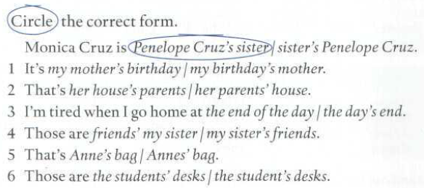
Page 131

Slide 15
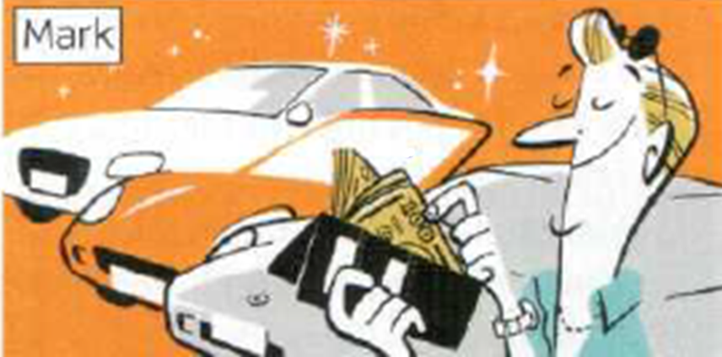
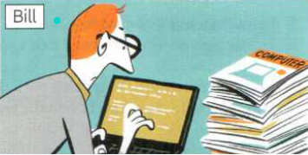
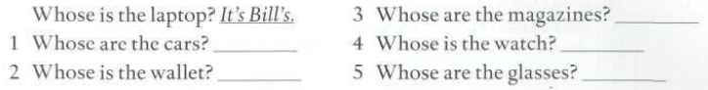
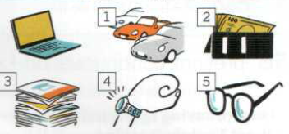
They’re Bill’s
They’re Mark’s
It’s Mark’s
It’s Mark’s
They’re Bill’s

Slide 16
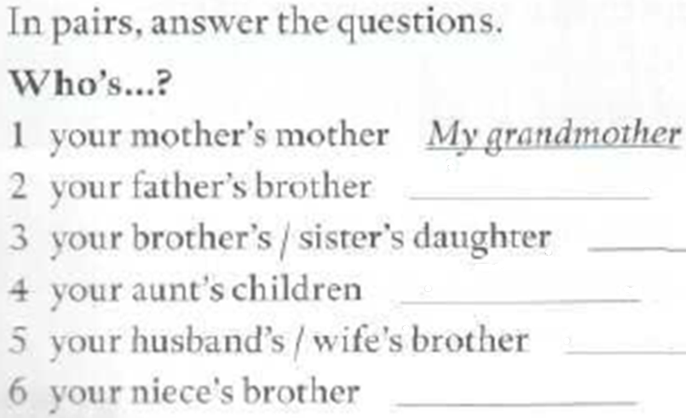
WHO’S…?
My uncle
My niece
My cousins
My brother-in-law
My nephew

